Slide 1

Innovative Project
Quantitative techniques PE-261
Divij Lavania (2K19/AE/023)
Dhruv Garg (2K19/AE/021)
SUBMITTED TO:- Dr. Saurabh Agrawal

Slide 2
PROFIT OPTIMIZATION OF
VARIOUS BUSINESS MODELS
USING LPP AND LINGO PROGRAMMING
(AIRLINE INDUSTRY)

Slide 3
Table of Contents
01
02
03
04
Objectives,
Introduction & Methodology
Profit Optimization of a Passenger Airline Company
Tables (1-6)&
Lindo Model
Result , Conclusion & References

Slide 4
OBJECTIVES
Introduction & Methodology
Profit Maximization of the company by flying more flights between four major cities in the India.
Developing a Lingo Model for finding optimal solutions for Various Transport problems.
To increase the number of flights and utilizing max. No. of slots between high demanding cities.

Slide 5
INTRODUCTION
Linear programming is one specialized mathematical decision-making aid .It is a mathematical method To achieve the maximum or minimum value of a linear function. Linear programming involves the planning of activities to obtain an optimal result, i.e. a result that reaches the specified goal best (according to the mathematical model) among all feasible alternatives
METHODOLOGY
I. Method of data collection :- For collecting data and ideas for this case study we referred to various research papers . We referred to various web pages to collect the prices for various air routes . Some airport officials were also interviewed for knowledge regarding expenses involved in Airways.

Slide 6
II. Method of Data Analysis :- The collected data will be first represented in tabular form and then formulation of the data will be done keeping in mind the constraints present in the problem.We have used the LINGO 19.0 Software to find the optimal solution and solve the LPP.
Profit Optimization of a Passenger Airline Company
Air transport has become one of the most used means of transport due to its affordability and comfort. So it has become a challenge for the airline companies to generate revenue without increasing the fare too much.So in this case study we have chosen the top 4 most busiest airports in India and devised a way by which we increase the profit of company by utilizing the available slots at those airports in such a manner that maximum profit can be generated within the given constraints. We have collected the data then formulated it and at the end we have used the Lingo software to find the optimal solution.

Slide 7
Table 1 Shows the Distance(in kms) between Top 4 Airports in the India. These airports are the busiest and most Important airport for both Domestic and International Travel .
DEL - Delhi BOM - Bombay BLR - Bengaluru MAA - Chennai
TABLE 1 - Distance (in km)
Cities
DEL
BOM
BLR
MAA
1148
1740
1756
DELHI
1148
845
1033
MUMBAI
1740
845
290
BENGALURU
1756
1033
290
CHENNAI

Slide 8
Total Expenditure= (Total Fuel x fuel cost)+ salary of staff.
Fuel Cost = ₹ 40000 per kilolitre (average of major cities in India)
Salary Of Staff= ₹ 1000000 per month ( 2 pilots + 6 crew) (Average used)
Per Flight= ₹34000 approx. Fuel Used =3.720 litres per kilometre
TABLE 2 - Total Expenditure(in ₹)
Cities
DEL
BOM
BLR
MAA
205000
293000
295000
DELHI
205000
160000
188000
MUMBAI
293000
160000
77000
BENGALURU
CHENNAI
295000
188000
77000

Slide 9
Total Expenditure= (Total Fuel x fuel cost)+ salary of staff.
Total Income Earned= (Total Passengers x Fare one way) - (Total
Expenditure)
Total Profit= Total Income - Total Expenditure (total 160 passengers)
TABLE 3 - Total Profit(in ₹)
Cities
DEL
BOM
BLR
MAA
198000
134000
114000
DELHI
198000
160000
200000
MUMBAI
134000
160000
118000
BENGALURU
118000
CHENNAI
114000
200000

Slide 10
Shows current utilization of slots in all 4cities. It depends on various factors such as length of the runway, number of runways, Maintenance Schedule of the airport and many others. (Approx. from various travel schedules).
TABLE 4 - Slots
Cities
DEL(1)
BOM(2)
BLR(3)
MAA(4)
No. of Slots
8
5
5
18
DELHI (1)
9
4
3
16
MUMBAI (2)
6
4
2
12
BENGALURU (3)
CHENNAI (4)
5
3
3
11
No. of Slots
20
15
12
10

Slide 11
Formulations
Max 198000x₁₂ + 134000x₁₃ + 114000x₁₄ + 198000x₂₁ + 160000x₂₃ + 200000x₂₄ + 134000x₃₁ + 160000x₃₂ + 118000x₃₄ +114000x₄₁ + 200000x₄₂ + 118000x₄₃
Subject to :- x₁₃>=1 ,x₂₃>=1 ,x₃₂>=1 ,x₄₂>=1
x₁₂>=1, x₂₁>=1 ,x₃₁>=1 ,x₄₁>=1 x₁₄>=1 ,x₂₄>=1 ,x₃₄>=1 ,x₄₃>=1
x₂₁+x₂₃+x₂₄<=16 x₄₁+x₄₂+x₄₃<=11 x₂₁+x₃₂+x₄₁<=20
x₁₂+x₃₂+x₄₂<=15 x₁₃+x₂₃+x₄₃<=12 x₁₄+x₂₄+x₃₄<=10
x₃₁+x₃₂+x₃₄<=12 x₁₂+x₁₃+x₁₄<=18

Slide 12
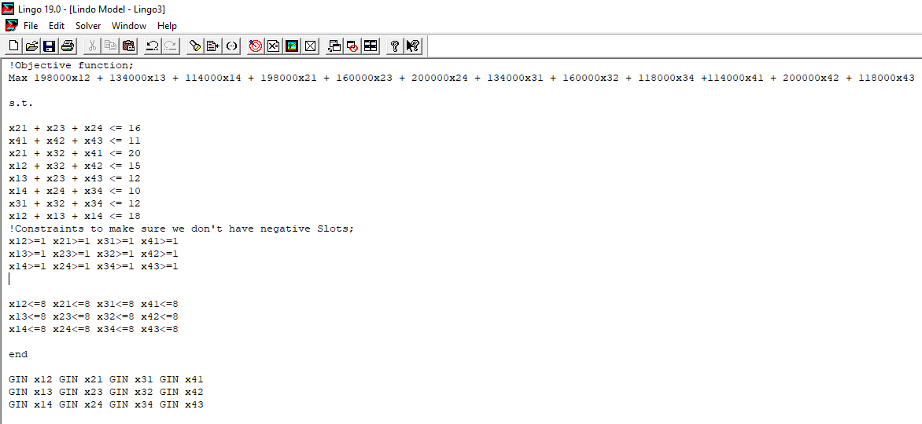
LINDO MODEL FOR PROFIT OPTIMIZATION

Slide 13
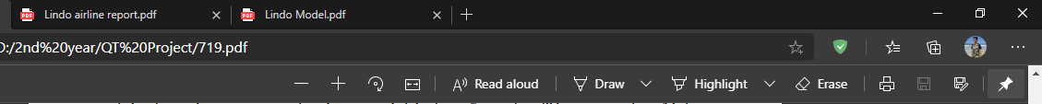
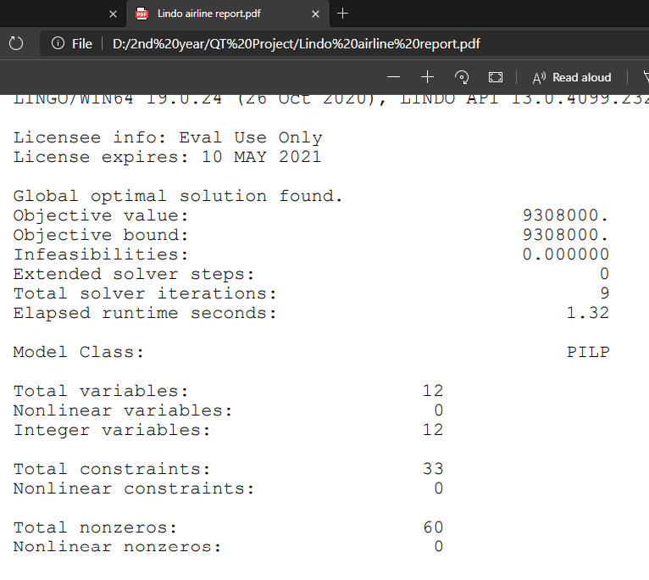
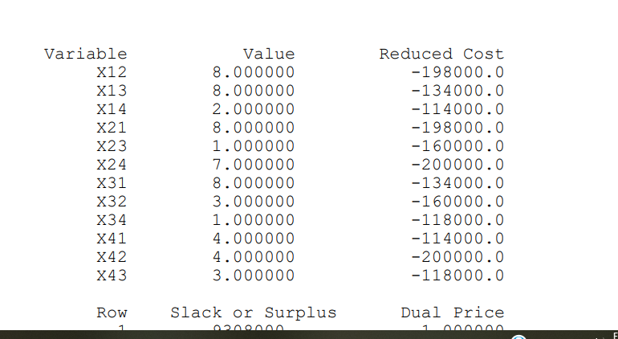

Slide 14
Shows current utilization of slots in all 4cities. The Optimized slots result now makes proper use of the available slot in the different airport which in turn results in an increase in profit of the airline
TABLE 5 - Optimized Slots (Solution)
Cities
DEL(1)
BOM(2)
BLR(3)
MAA(4)
No. of Slots
8
8
2
18
DELHI (1)
8
1
7
16
MUMBAI (2)
8
3
1
12
BENGALURU (3)
CHENNAI (4)
4
4
3
11
No. of Slots
20
15
12
10

Slide 15
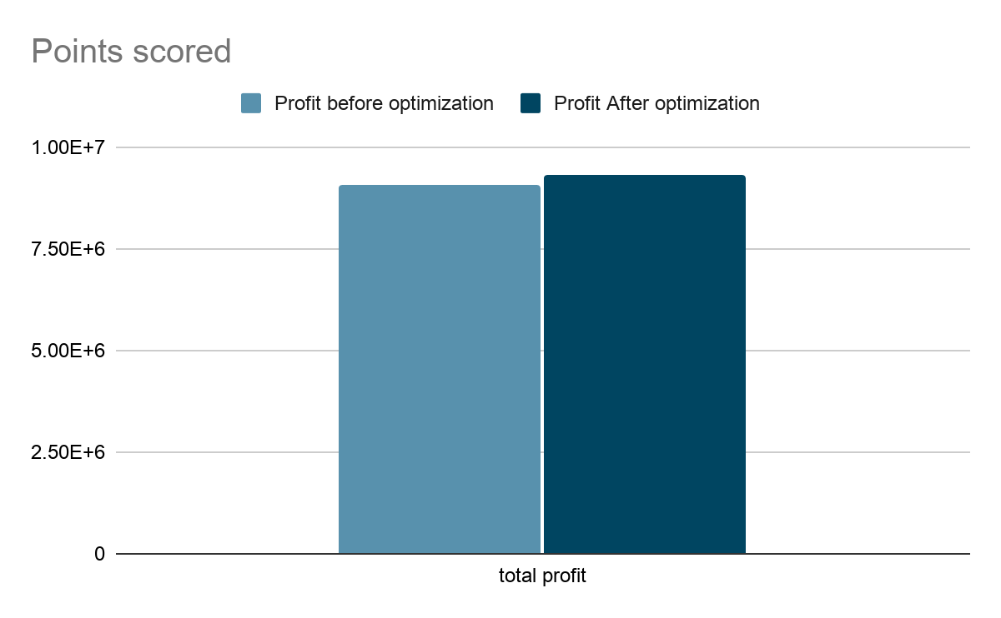
TABLE 6 - Final Profit After Optimization(₹)
Cities
DEL(1)
BOM(2)
BLR(3)
MAA(4)
0
402000
-342000
DELHI (1)
-198000
-480000
800000
MUMBAI (2)
268000
-160000
-118000
BENGALURU (3)
CHENNAI (4)
-114000
200000
0
Total Profit
₹ 258000 per day
Profit before Slot optimization=₹ 9050000
Profit after Slot optimization=₹ 9308000
Increase in profit in a year = ₹ 94170000

Slide 16
RESULTS
We did the slot utilization of 4 major and busiest airports in India i.e. Delhi, Mumbai, Bengaluru, Chennai .The optimized result now makes proper use of the available slots between these cities . A net profit of INR 258000 (approx.) per day was increased which lead to approx INR 9.5 Crores increase in revenue of budget airlines per year between only 4 cities.
If this model is applied on a larger part or cities of the airline company there will be a great increases to the revenue of company. This model can also be used to the other sectors of the airline industry such as staff scheduling ,Boarding procedure, vehicle scheduling and maintenance of aircrafts.

Slide 17
CONCLUSION
By doing formulation of a linear programming problem and using LINGO programming and solver the profit of a company can be increased to considerable amount as shown in this case study .This step could turn out to be great plan and prevent companies like jet airways from bankruptcy.
This case study can also be applied to other transport industries mainly public transports like Local bus services ,Train slots and number of coaches in a specific train can also be optimized according to profit across the country.It can also be used for staff scheduling ,Route structuring.

Slide 18
REFERENCES
Patel P. , Ali A. , 2018,“Budget Airline Operations Optimization using Linear Programming”. A. Leon Linton Department of Mechanical Engineering, Lawrence Technological University Southfield, IEOM Society International.
Data collected from google and various websites of respective airline companies.
URL of software used - https://www.lindo.com/
Theme -https://slidesgo.com/

Slide 19
THANKYOU!

